Slide 1
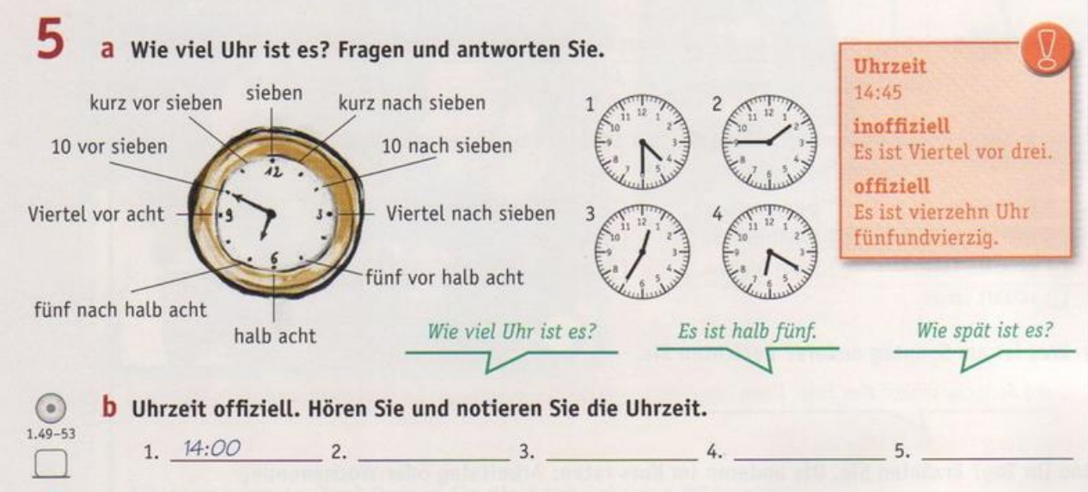
Die Zeit - Time

Slide 2
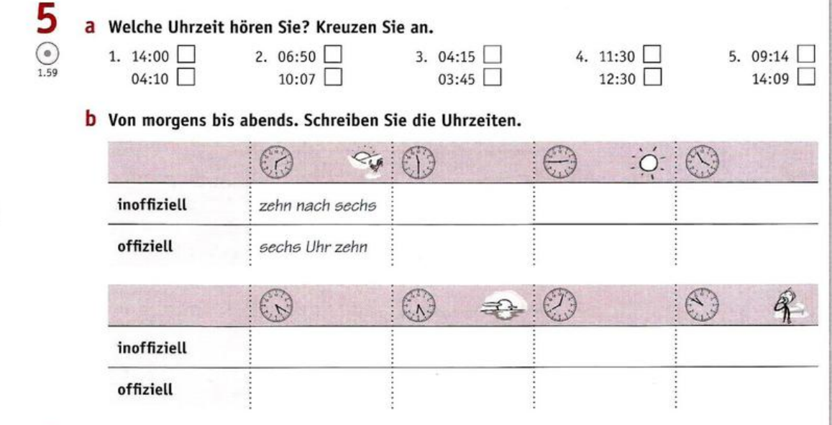

Slide 3
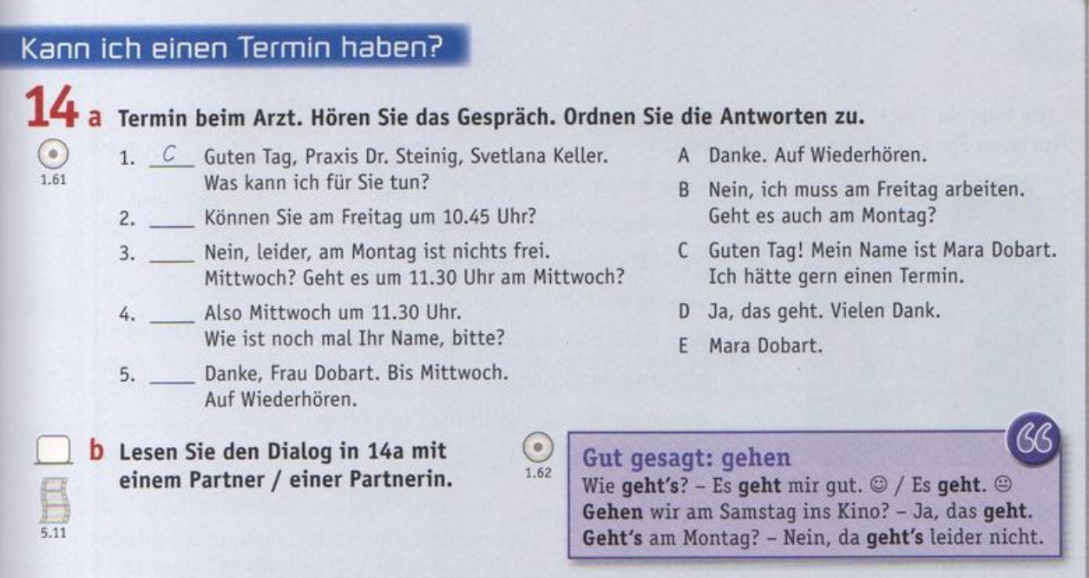

Slide 4
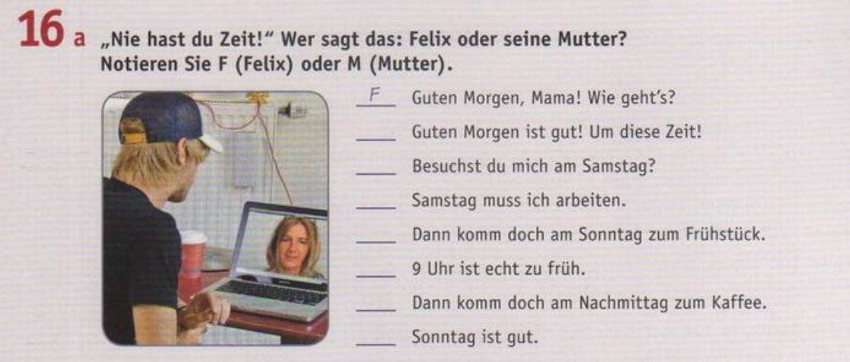
https://www.youtube.com/watch?v=G-uck0Ql7w0&list=PLpZinO6zXqCKNsMRLzfFjpgGlpPNTbA6R&index=10

Slide 5
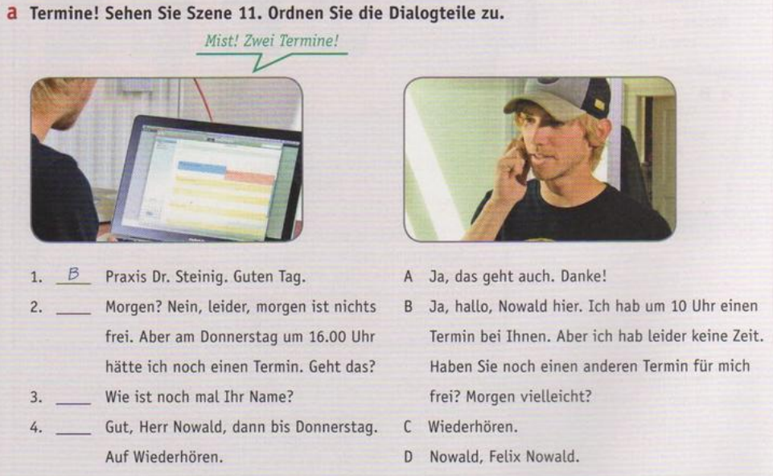
https://www.youtube.com/watch?v=4ggC6vjgcnc&list=PLpZinO6zXqCKNsMRLzfFjpgGlpPNTbA6R&index=11

Slide 6
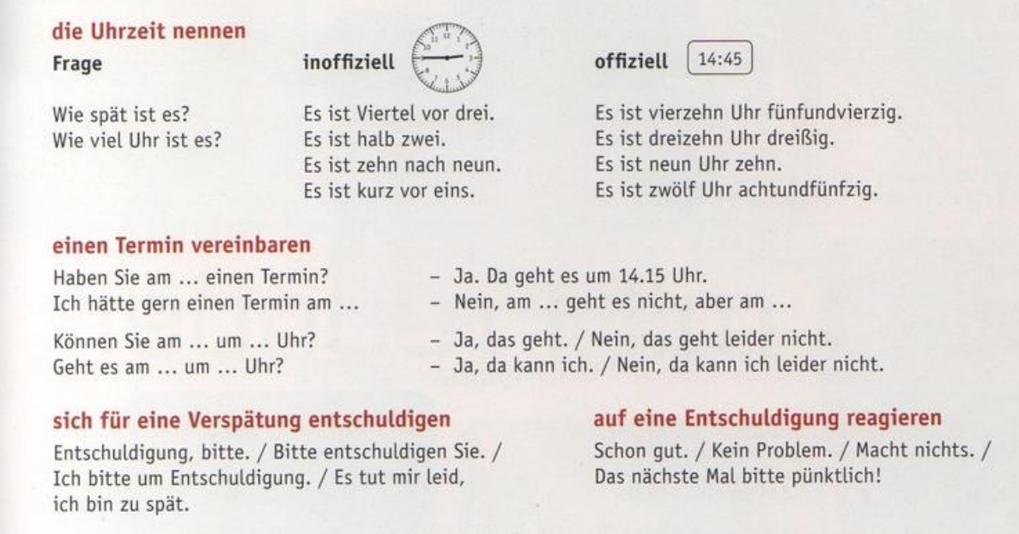

Slide 7
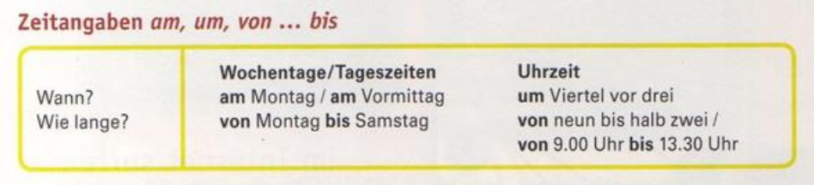
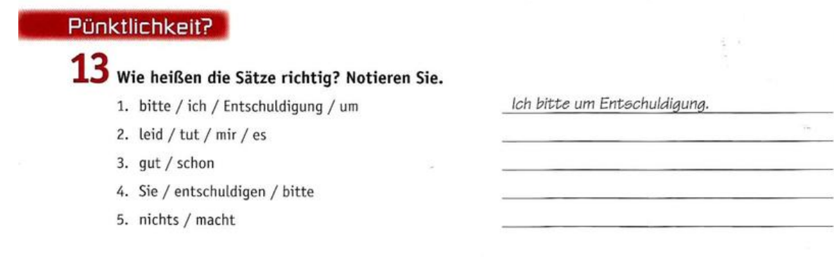

Slide 8
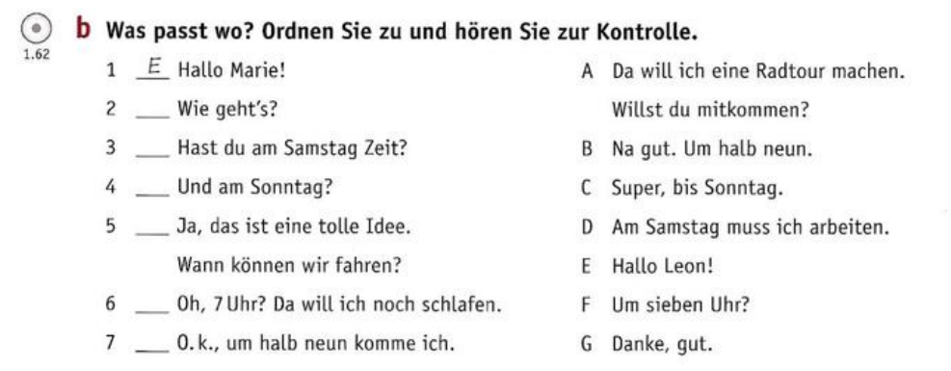
AB - 62

